Slide 1
Data Structures and Algorithms
Manish Aryal

Slide 2
Searching
Contents
Sequential Search
Binary Search
Hashing

Slide 3
Sequential Search
A sequential search of a list/array begins at the beginning of the list/array and continues until the item is found or the entire list/array has been searched

Slide 4
Sequential Search
bool LinSearch(double x[ ], int n, double item)
{
for(int i=0;i<n;i++){
if(x[i]==item) return true;
else return false;
}
return false;
}

Slide 5



Search Algorithms
Suppose that there are n elements in the array. The following expression gives the average number of comparisons:
It is known that
Therefore, the following expression gives the average number of comparisons made by the sequential search in the successful case:

Slide 6
Search Algorithms

Slide 7
Binary Search
A binary search looks for an item in a list using a divide-and-conquer strategy

Slide 8
Binary Search
Binary search algorithm assumes that the items in the array being searched are sorted
The algorithm begins at the middle of the array in a binary search
If the item for which we are searching is less than the item in the middle, we know that the item won’t be in the second half of the array
Once again we examine the “middle” element
The process continues with each comparison cutting in half the portion of the array where the item might be

Slide 9
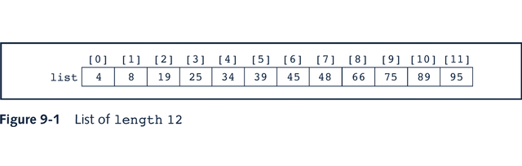
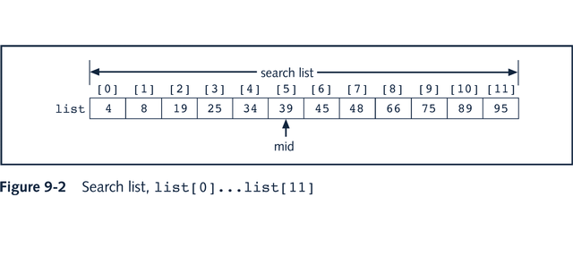
Binary Search

Slide 10
Binary Search: middle element
left + right
mid =
2

Slide 11
Binary Search
bool BinSearch(double list[ ], int n, double item, int&index){
int left=0;
int right=n-1;
int mid;
while(left<=right){
mid=(left+right)/2;
if(item> list [mid]){ left=mid+1; }
else if(item< list [mid]){right=mid-1;}
else{
item= list [mid];
index=mid;
return true; }
}// while
return false;
}

Slide 12
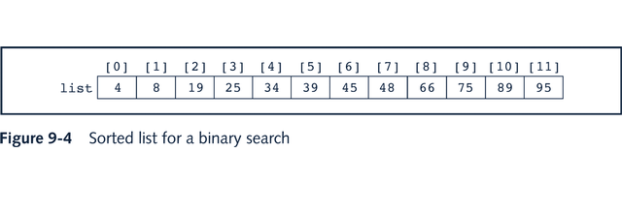
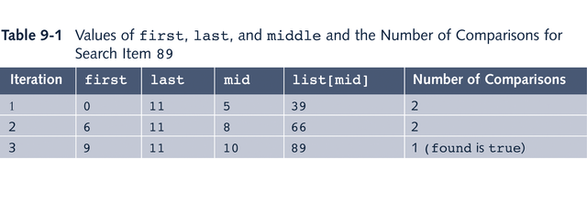
Binary Search: Example

Slide 13
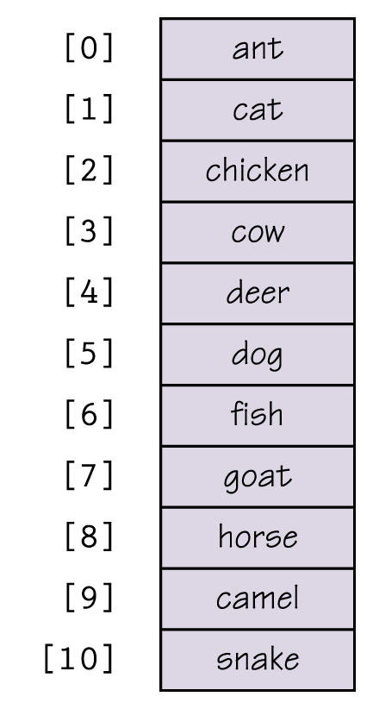
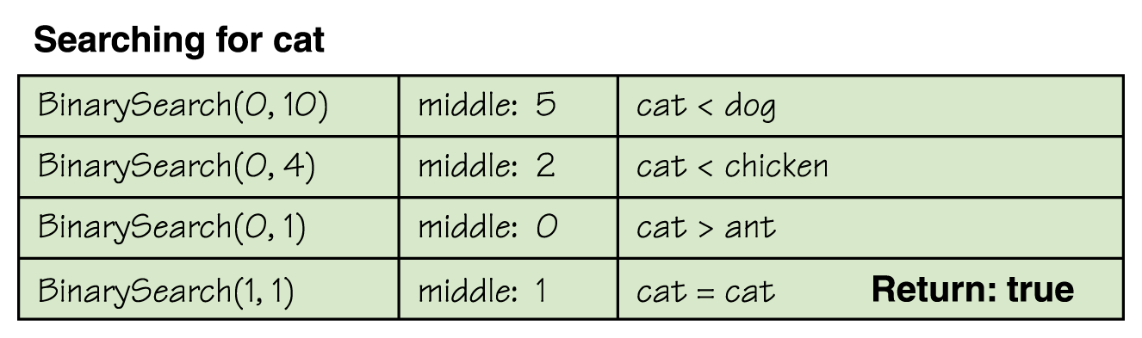
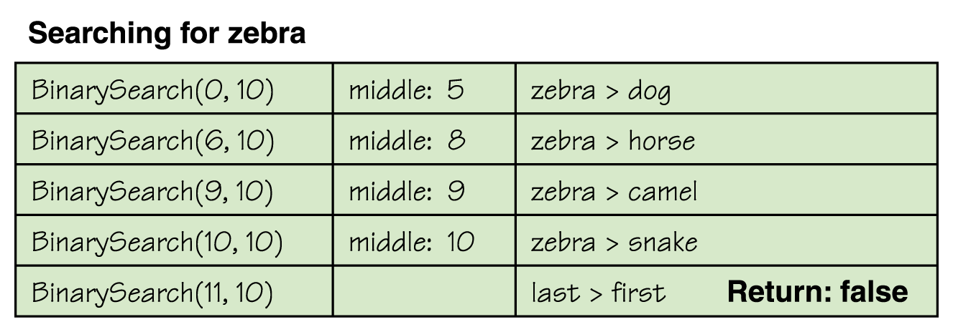
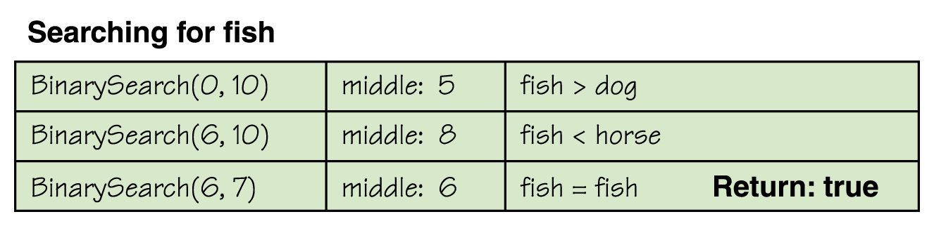
Binary Search

Slide 14
Binary Search

Slide 15
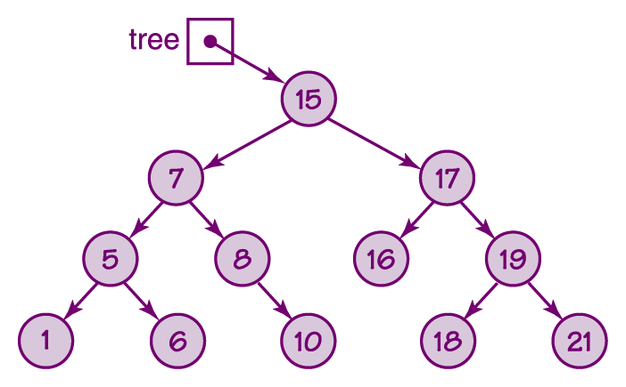
Binary Search Tree

Slide 16
Binary Search Tree
bool search(Node * root, int id)
{
bool found = false;
if(root == NULL) return false;
if(root->data == id) {
cout<<" The node is found "<<endl; found = true;
}
if(!found) found = search(root->left, id);
if(!found) found = search(root->right, id);
return found;
}

Slide 17
Binary Search Tree

Slide 18
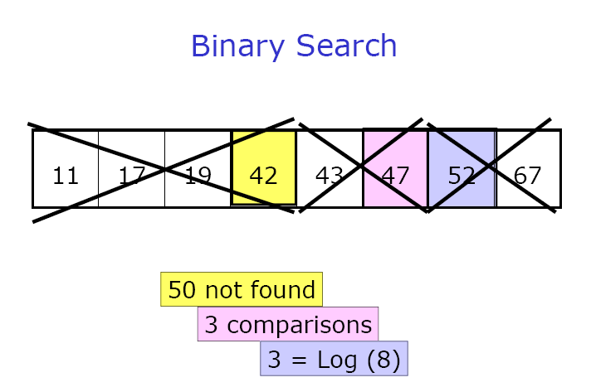
Binary Search Tree

Slide 19
Binary Search Tree

Slide 20
Hashing:Basic Concepts
Sequential search: O(n) Requiring several
key comparisons
Binary search: O(log₂n) before the target is found

Slide 21
Basic Concepts
Search complexity:
Size | Binary | Sequential (Average) | Sequential (Worst Case)
16 | 4 | 8 | 16
50 | 6 | 25 | 50
256 | 8 | 128 | 256
1,000 | 10 | 500 | 1,000
10,000 | 14 | 5,000 | 10,000
100,000 | 17 | 50,000 | 100,000
1,000,000 | 20 | 500,000 | 1,000,000

Slide 22
Hashing: Basic Concepts
keys
memory addresses
hashing
Each key has only one address

Slide 23
Hashing: Basic Concepts
001 | Harry Lee
002 | Sarah Trapp
005 | Vu Nguyen
007 | Ray Black
100 | John Adams
Key
Address
005
Vu Nguyen 102002
John Adams 107095
Sarah Trapp 111060
Hash
Function
100
002

Slide 24
Hashing: Basic Concepts
Home address: address produced by a hash function.
Prime area: memory that contains all the home addresses.

Slide 25
Hashing: Basic Concepts
Synonyms: a set of keys that hash to the same location.
Collision: the location of the data to be inserted is already occupied by the synonym data.

Slide 26
Hashing: Basic Concepts
Ideal hashing:
No location collision
Compact address space

Slide 27
Hashing: Basic Concepts
Insert A, B, C
hash(A) = 9
hash(B) = 9
hash(C) = 17
 |  |  |  |  |  |  |  | A
[1] |  |  |  | [5] |  |  |  | [9] |  |  |  |  |  |  |  | [17]

Slide 28
Hashing: Basic Concepts
Insert A, B, C
hash(A) = 9
hash(B) = 9
hash(C) = 17
B and A
collide at 9
 |  |  |  |  |  |  |  | A |  |  |  |  |  |  |  | B
[1] |  |  |  | [5] |  |  |  | [9] |  |  |  |  |  |  |  | [17]
Collision Resolution

Slide 29
Hashing: Basic Concepts
Insert A, B, C
hash(A) = 9
hash(B) = 9
hash(C) = 17
B and A
collide at 9
B and A
collide at 9
C and B
collide at 17
 |  |  |  | C |  |  |  | A |  |  |  |  |  |  |  | B
[1] |  |  |  | [5] |  |  |  | [9] |  |  |  |  |  |  |  | [17]
Collision Resolution

Slide 30
Hashing: Basic Concepts
Searh for B
hash(A) = 9
hash(B) = 9
hash(C) = 17
 |  |  |  | C |  |  |  | A |  |  |  |  |  |  |  | B
[1] |  |  |  | [5] |  |  |  | [9] |  |  |  |  |  |  |  | [17]
Probing

Slide 31
Hash Functions
Direct hashing
Modulo division
Digit extraction
Mid-square
Pseudo-random

Slide 32
Direct Hashing
The address is the key itself:
hash(Key) = Key

Slide 33
Direct Hashing
Advantage: there is no collision.
Disadvantage: the address space (storage size) is as large as the key space

Slide 34
Modulo Division
Address = Key MOD listSize + 1
Fewer collisions if listSize is a prime number
Example:
Numbering system to handle 1,000,000 employees
Data space to store up to 300 employees
hash(121267) = 121267 MOD 307 + 1 = 2 + 1 = 3

Slide 35
Digit Extraction
Address = selected digits from Key
Example:
379452 → 394
121267 → 112
378845 → 388
160252 → 102
045128 → 051

Slide 36
Mid-square
Address = middle digits of Key²
Example:
9452 * 9452 = 89340304 → 3403

Slide 37
Mid-square
Disadvantage: the size of the Key² is too large
Variations: use only a portion of the key
379452: 379 * 379 = 143641 → 364
121267: 121 * 121 = 014641 → 464
045128: 045 * 045 = 002025 → 202

Slide 38
Pseudorandom
Pseudorandom
Number Generator
Random
Number
Modulo
Division
Key
Address
y = ax + c
For maximum efficiency, a and c should be prime numbers

Slide 39
Pseudorandom
Example:
Key = 121267 a = 17 c = 7 listSize = 307
Address = ((17*121267 + 7) MOD 307 + 1
= (2061539 + 7) MOD 307 + 1
= 2061546 MOD 307 + 1
= 41 + 1
= 42

Slide 40
Collision Resolution
Except for the direct hashing, none of the others are one-to-one mapping
⇒ Requiring collision resolution methods
Each collision resolution method can be used independently with each hash function

Slide 41
Collision Resolution
As data are added and collisions are resolved, hashing tends to cause data to group within the list
⇒ Clustering: data are unevenly distributed across the list
High degree of clustering increases the number of probes to locate an element
⇒ Minimize clustering

Slide 42
Collision Resolution
Primary clustering: data become clustered around a home address.
Insert A₉, B₉, C₉, D₁₁, E₁₂
 |  |  |  |  |  |  |  | A | B | C | D | E
[1] |  |  |  |  |  |  |  | [9] [10] [11] [12] [13]

Slide 43
Collision Resolution
Secondary clustering: data become grouped along a collision path throughout a list.
Insert A₉, B₉, C₉, D₁₁, E₁₂, F₉
 |  |  |  |  |  |  |  | A | B | D | E |  | C |  |  |  |  |  |  |  | F
[1] |  |  |  |  |  |  |  | [9] [10] [11] [12] [13] [14] [23]

Slide 44
Collision Resolution
Open addressing
Linked list resolution
Bucket hashing

Slide 45
Open Addressing
When a key is colliding with another key, the collision is resolved by finding a nearest empty space by probing the cells

Slide 46
Open Addressing
Algorithm hashInsert (ref T <array>, val k <key>)
Inserts key k into table T
1 i = 0
2 loop (i < m)
1 j = hp(k, i)
2 if (T[j] = nil)
1 T[j] = k
2 return j
3 else
1 i = i + 1
3 return error: “hash table overflow”
End hashInsert

Slide 47
Open Addressing
Algorithm hashSearch (val T <array>, val k <key>)
Searches for key k in table T
1 i = 0
2 loop (i < m)
1 j = hp(k, i)
2 if (T[j] = k)
1 return j
3 else if (T[j] = nil)
1 return nil
4 else
1 i = i + 1
3 return nil
End hashSearch

Slide 48
Open Addressing
There are different methods:
Linear probing
Quadratic probing
Double hashing
Key offset

Slide 49
Linear Probing
When a home address is occupied, go to the next address (the current address + 1):
hp(k, i) = (h(k) + i) MOD m

Slide 50
Linear Probing
001 | Mary Dodd (379452)
002 | Sarah Trapp (070918)
003 | Bryan Devaux (121267)
008 | John Carver (378845)
306 | Tuan Ngo (160252)
307 | Shouli Feldman (045128)
Hash
Function
Harry Eagle 166702
002

Slide 51
Linear Probing
001 | Mary Dodd (379452)
002 | Sarah Trapp (070918)
003 | Bryan Devaux (121267)
004 | Harry Eagle (166702)
008 | John Carver (378845)
306 | Tuan Ngo (160252)
307 | Shouli Feldman (045128)
Hash
Function
Harry Eagle 166702
002

Slide 52
Linear Probing
Advantages:
quite simple to implement
data tend to remain near their home address
(significant for disk addresses)
Disadvantages:
produces primary clustering

Slide 53
Quadratic Probing
The address increment is the collision probe number squared:
hp(k, i) = (h(k) + i²) MOD m

Slide 54
Quadratic Probing
Advantages:
works much better than linear probing
Disadvantages:
time required to square numbers
produces secondary clustering
h(k₁) = h(k₂) ⇒ hp(k₁, i) = hp(k₂, i)

Slide 55
Double Hashing
Using two hash functions:
hp(k, i) = (h₁(k) + ih₂(k)) MOD m

Slide 56
Key Offset
The new address is a function of the collision address and the key.
offset = [key / listSize]
newAddress = (collisionAddress + offset) MOD listSize

Slide 57
Key Offset
The new address is a function of the collision address and the key.
offset = [key / listSize]
newAddress = (collisionAddress + offset) MOD listSize
hp(k, i) = (hp(k, i-1) + [k/m]) MOD m

Slide 58
Linked List Resolution/Chaining
Major disadvantage of Open Addressing: each collision resolution increases the probability for future collisions.
⇒ use linked lists to store synonyms

Slide 59
Linked List Resolution
001 | Mary Dodd (379452)
002 | Sarah Trapp (070918)
003 | Bryan Devaux (121267)
008 | John Carver (378845)
306 | Tuan Ngo (160252)
307 | Shouli Feldman (045128)
Harry Eagle (166702)
Chris Walljasper (572556)
overflow area
prime area

Slide 60
Bucket Hashing
Hashing data to buckets that can hold multiple pieces of data.
Each bucket has an address and collisions are postponed until the bucket is full.

Slide 61
Bucket Hashing
001 | Mary Dodd (379452)
002 | Sarah Trapp (070918)
 | Harry Eagle (166702)
 | Ann Georgis (367173)
003 | Bryan Devaux (121267)
 | Chris Walljasper(572556)
307 | Shouli Feldman (045128)
linear probing

Slide 62
Hashing
Indexing = Hashing

Slide 63
Readings
Ch. 9 Growth Functions
Ch. 10 Graphs

Slide 64
Review
Concepts of Data Structures
Stack and Queue
List and Linked List
Recursion
Trees
Sorting
Searching

Slide 65
Thank You.

